Slide 1

“NLP-NAMED ENTITY RECOGNITION IN INDIA”
SIR M VISVESVARAYA INSTITUTE OF TECHNOLOGY BANGALURU-157
DEPARTMENT OF COMPUTER APPLICATIONS
Internal Guide: Dr. C.H. Vanipriya
professor and HOD,
Dept of MCA
Sir MVIT
External Guide: Mr. Sagar Rautray,
Vice President,
Valuepitch E Technologies
Pvt. Ltd Maharashtra-400709

Slide 2
Detailed Design for NLP-NER in India:
System Architecture:
The NLP-NER system will follow a client-server architecture.
The client application will be responsible for taking input text data and sending it to the server for processing.
Data Preprocessing:
Text data will undergo preprocessing steps to clean and normalize the input.
Preprocessing may include tasks such as tokenization, stemming, stop-word removal, and lowercasing.
Any special considerations for Indian languages, such as handling compound words or specific linguistic rules, will be addressed during this stage.

Slide 3
Detailed Design for NLP-NER in India:
Named Entity Recognition Model:
The system will utilize a pre-trained NER model specific to Indian languages.
The model will be based on deep learning techniques, such as recurrent neural networks (RNN) or transformer-based architectures like BERT.
The model will be trained on annotated datasets containing person names, state and district names, and other relevant named entities in the Indian context.
Entity Detection and Classification:
The NER model will perform entity detection and classification on the preprocessed text data.
It will identify and categorize named entities into predefined classes such as person, location, organization, etc.
The model will utilize contextual information, linguistic features, and trained representations to make accurate predictions.

Slide 4
Detailed Design for NLP-NER in India:
Post-processing and Formatting:
The recognized named entities will undergo post-processing to ensure coherence and consistency.
Post-processing may involve tasks like disambiguation, resolving overlapping entities, and formatting the output in a standardized manner.
The final output will include identified named entities with their corresponding entity types, such as person names, state names, and district names.
User Interface:
The client application will provide a user-friendly interface for users to input text and receive the named entity recognition results.
The interface may include features like text input fields, result displays, and options for selecting specific entity types or regions of interest.

Slide 5
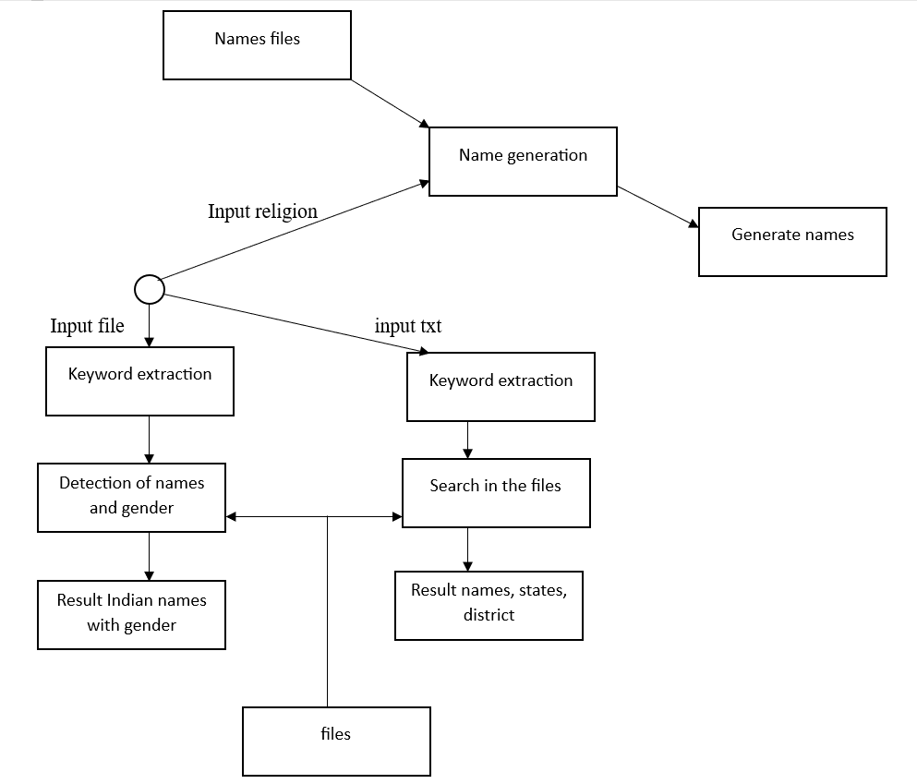
Detailed Design for NLP-NER in India:
Fig 1 : Detail design

Slide 6
Detailed Design for NLP-NER in India:
The above figure shows the detailed design.
Detailed design shows how the system will work.
The system when starts execution the user asked to give input in the form of image, pdf, text document etc.. to recognize character.
When input file is accepted then it will examine type of file, then it starts extracting character from it.
Then it separates the entity.
For name generation user has to asked to give religious name to generate names.

Slide 7
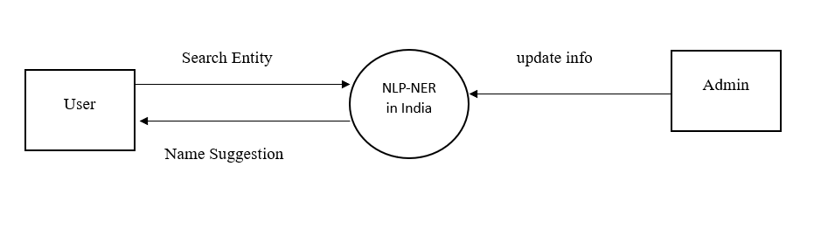
DFD Level-0 :
Fig 2 : DFD level-0
The DFD stands for dataflow diagram.
The level 0 dfd shows the context diagram.
It hides abstractions. It only shows the overview of main functionality.
In the above diagram the user of the system will gives input file from which he get result in entity. Also system will generate the names on some religious.

Slide 8
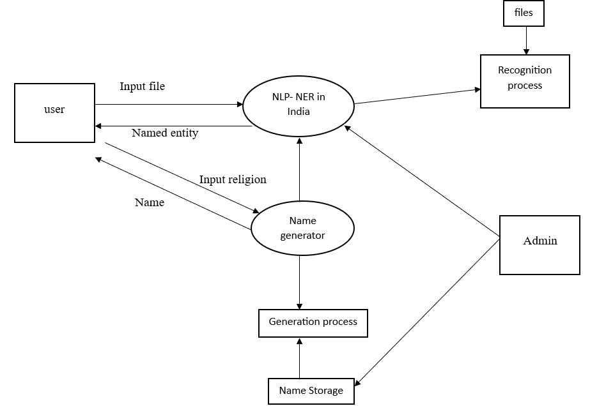
DFD Level-1 :
Fig 3 : DFD level-1

Slide 9
DFD Level-1 :
The DFD level 1 shows the system flow in details.
In the above diagram the user of the system can give input in any format. Then system will find the type of file then it starts to extract the characters from the input file.
Then it will recognize the characters form extracted text.
Then system can also generate names based on input by user in the form of religios and starting word.

Slide 10
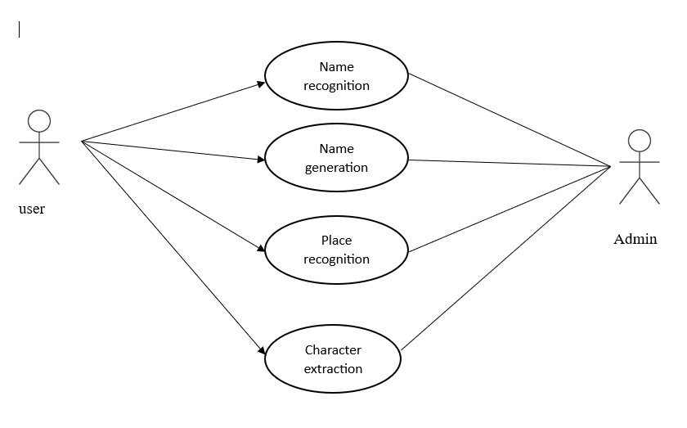
Use case:
Fig 4 : Use case diagram

Slide 11
Use case:
The use case diagram defines how user will interact with the system.
In the above diagram it shows user can interact with the system for character extraction, name recognition, place recognition, name generation etc..

Slide 12
Algorithm:
Entity recognition
Start
Read image
Extract character
Separate keywords from extracted character
Recognize name, state, district etc..
Display result
Stop

Slide 13
Algorithm:
Name generation
1. start
2. read religion
3. read starting word
4. search in files
5. display names
6. stop

Slide 14
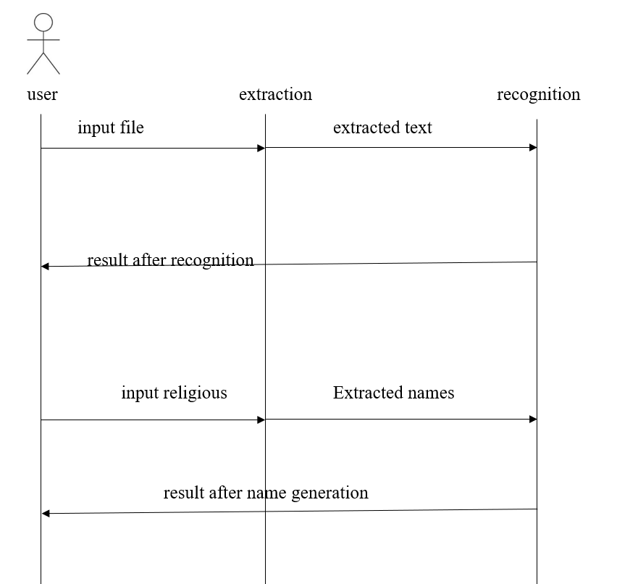
Sequence diagram:
Fig 5 : Sequence diagram

Slide 15
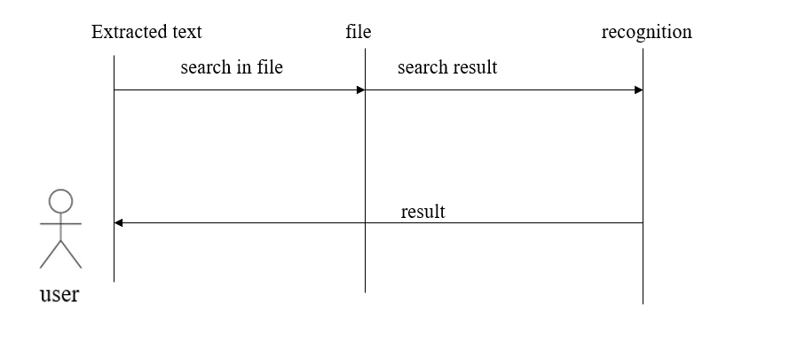
Sequence diagram of name recognition:
Fig 6 : Sequence diagram of name recognition

Slide 16
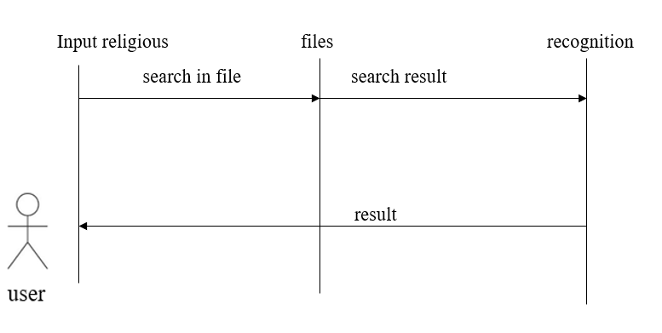
Sequence diagram of name generation:
Fig 7 : Sequence diagram of name generation

Slide 17
Sequence diagram of name generation:
Fig 8 : Sequence diagram of name generation

Slide 18
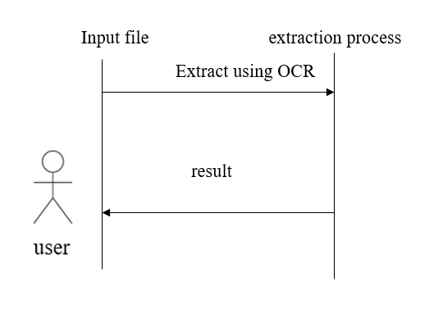
Sequence diagram of character extraction:
Fig 9 : Sequence diagram of character extraction

Slide 19
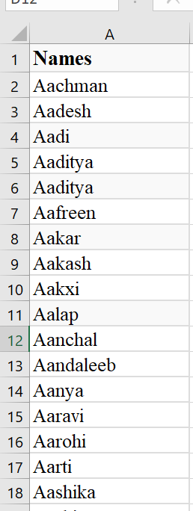
Sample Name List:

